Slide 1
To look forward to
Part 4: Rev 19:11-21
Preached by Dr. Jim Harmeling at Crossroads International Church Singapore • CICFamily.com Uploaded by Dr. Rick Griffith • Singapore Bible College Files in many languages for free download at BibleStudyDownloads.org

Slide 2
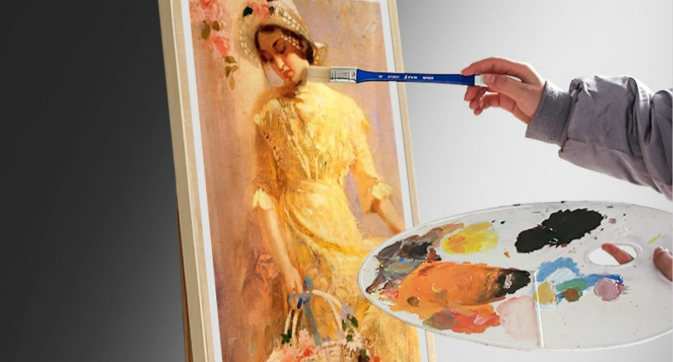

Slide 4
To look forward to
Fixing our sight on God’s revelation of the future

Slide 5
1 Jesus is here!
2–3 Churches get ready!
4–18 Global judgment
19:1-10 Wedding Time!

Slide 6
Acts 1:9-11
⁹ And when he had said these things, as they were looking on, he was lifted up, and a cloud took him out of their sight. ¹⁰ And while they were gazing into heaven as he went, behold, two men stood by them in white robes, ¹¹ and said, “Men of Galilee, why do you stand looking into heaven? This Jesus, who was taken up from you into heaven, will come in the same way as you saw him go into heaven.”

Slide 7
Philippians 3:20-21
²⁰ But our citizenship is in heaven, and from it we await a Savior, the Lord Jesus Christ, ²¹ who will transform our lowly body to be like his glorious body, by the power that enables him even to subject all things to himself.

Slide 8
Rejoice! Evil is Defeated (vs. 1-5)
Rejoice! The King Reigns and His Bride is Ready (vs. 6-10)
Behold! He comes (vs. 11-21)

Slide 9
White horse (11)
Jesus (11-16)
eyes of fire
many crowns
unknown written name
robe dipped in blood
sword in mouth
name written on robe
Armies of heaven in white (14)

Slide 10
Revelation 1
Jesus
robe with gold sash
white hair
eyes of fire
feet like burning metal
voice like waterfall
7 stars in hand
sword in mouth
face like the sun

Slide 11
Revelation 19
Jesus’ actions (15-21)
judge and rule the nations
Isaiah 11:4
but with righteousness he shall judge the poor, and decide with equity for the meek of the earth; and he shall strike the earth with the rod of his mouth, and with the breath of his lips he shall kill the wicked.

Slide 12
Revelation 19
Jesus’ actions (15-21)
judge and rule the nations
destroy rebellion

Slide 13
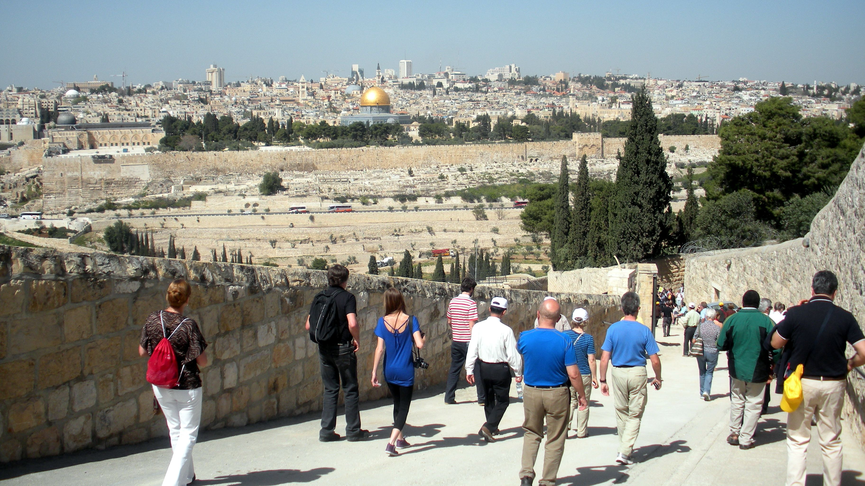
Zechariah 14:3-5, 9
³ Then the Lord will go out and fight against those nations as when he fights on a day of battle. ⁴ On that day his feet shall stand on the Mount of Olives that lies before Jerusalem on the east, and the Mount of Olives shall be split in two from east to west by a very wide valley, so that one half of the Mount shall move northward, and the other half southward. ⁵ And you shall flee to the valley of my mountains, for the valley of the mountains shall reach to Azal. And you shall flee as you fled from the earthquake in the days of Uzziah king of Judah. Then the Lord my God will come, and all the holy ones with him.
⁹ And the Lord will be king over all the earth. On that day the Lord will be one and his name one.

Slide 15
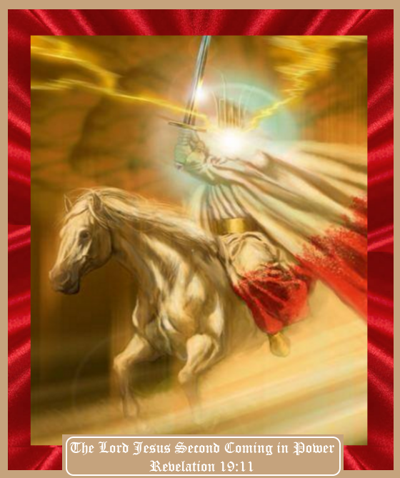

Slide 16
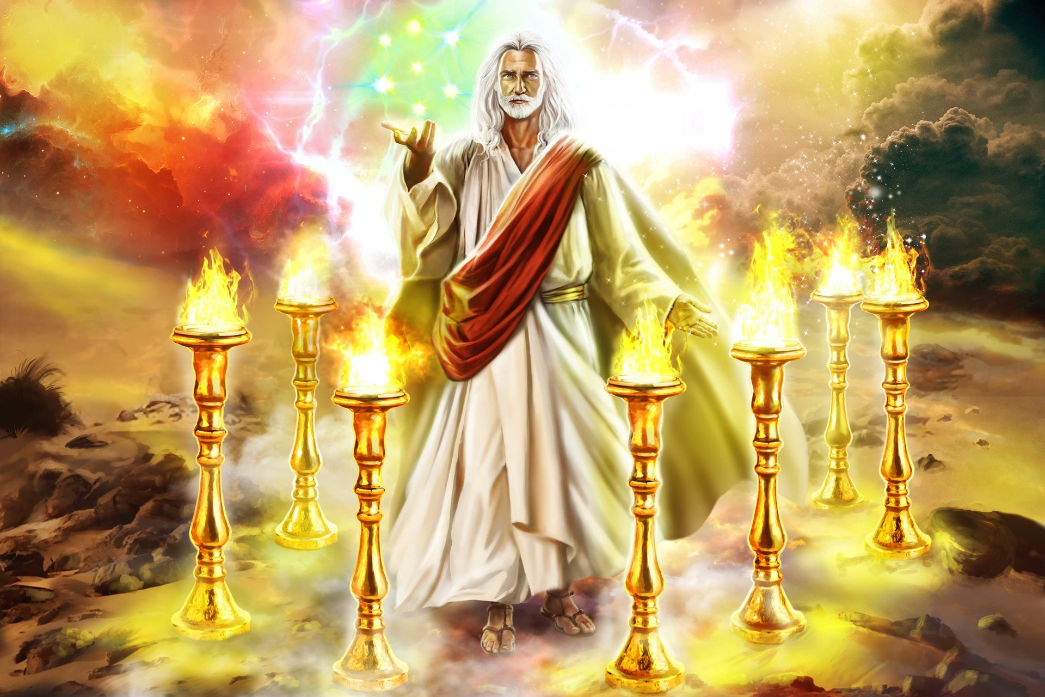

Slide 17
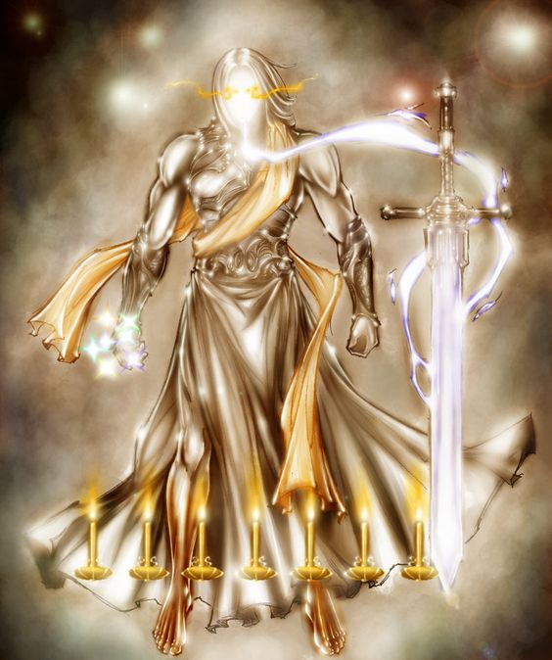

Slide 18
Luke 18:8
When the Son of Man comes, will he find faith on earth?

Slide 19
Black

Slide 20
Topical Preaching link at BibleStudyDownloads.org
Get this presentation for free!
Notes:
The Bible…Basically (bb)

